Slide 1
Introduction to Python - Lecture 4
Tom Ostler
Make sure you are logged onto your machine! You will need it throughout the session.

Slide 2
Overview of this lecture
In the first part of this lecture we are going to do two examples of plotting with matplotlib. This will then be followed by examples on curve fitting.
Example 1 of this lecture will show you how to:
Plot functions - with lines
Label axes
Create legends
Example 2 of this lecture will show you how to:
Plot data - with points

Slide 3
Curve fitting
Before we do an example of how to do curve fitting, we need to briefly discuss curve fitting.
Broadly speaking, curve fitting is the process of finding a function with a set of parameters that best fits a given set of data. It is widely used in physics and is an extremely useful skill.
Sometimes, the data is not well understood in terms of the model or underlying physical processes that generated such data.
However, curve fitting can sometimes be used to gain an insight into the data, e.g. the width of a curve can give you some information on the spread or dispersion of data.

Slide 4
Curve fitting
Curve fitting can sometimes be used to predict treands by extrapolating or interpolating a fit, however, care must be taken when doing this, especially if we do not understand why a curve has a given form. For example, suppose we take some data that looks like the graph on the right.

Slide 5
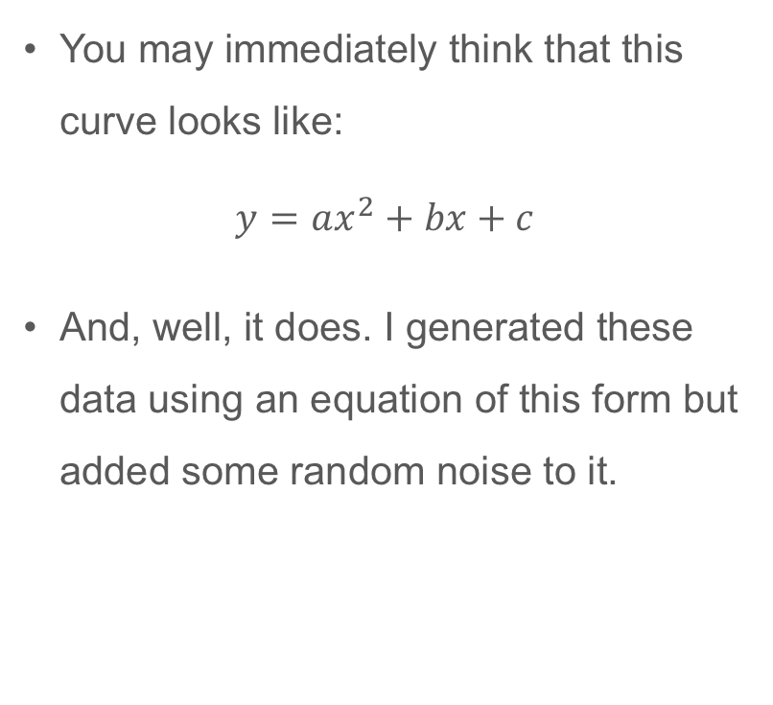
Curve fitting
You may immediately think that this curve looks like:
$$y=ax^{2}+bx+c$$
And, well, it does. I generated these data using an equation of this form but added some random noise to it.

Slide 6
Curve fitting - general procedure
Select a function that you think might fit the data. Or use a function that a theoretical model predicts. This will have some parameters that need to be varied
Choose some starting parameters.
Use some software to adjust your parameters to find “good” values of the parameters.

Slide 7
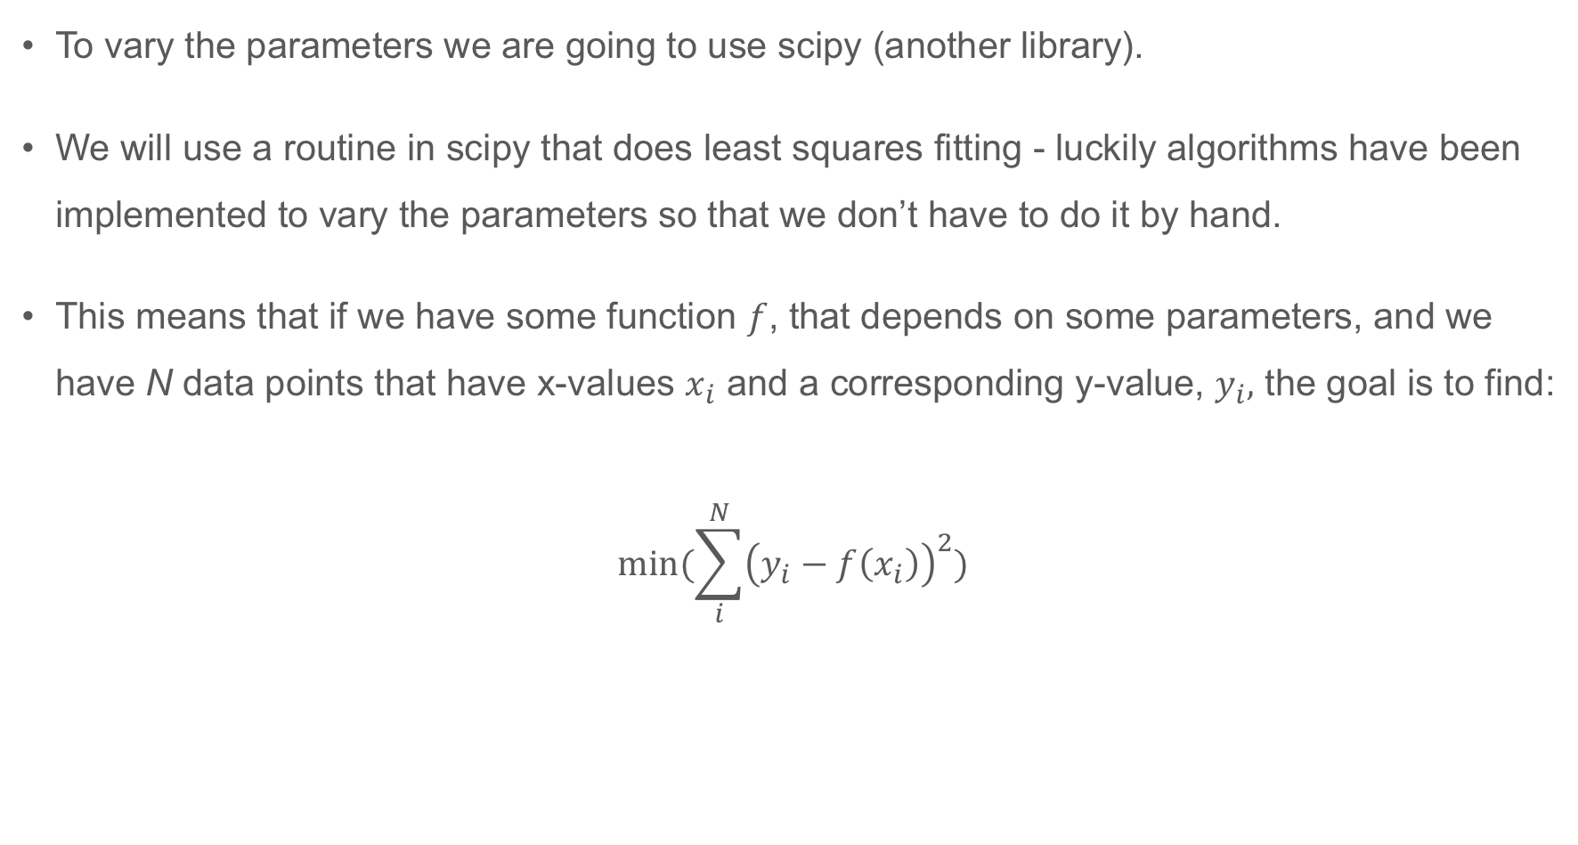
Curve fitting - general procedure
To vary the parameters we are going to use scipy (another library).
We will use a routine in scipy that does least squares fitting - luckily algorithms have been implemented to vary the parameters so that we don’t have to do it by hand.
This means that if we have some function $f$, that depends on some parameters, and we have N data points that have x-values $x_{i}$ and a corresponding y-value, $y_{i},$ the goal is to find:
$$min⁡(\sum_{i}^{N}{{\left(y_{i}−f\left(x_{i}\right)\right)}^{2}})$$

Slide 8
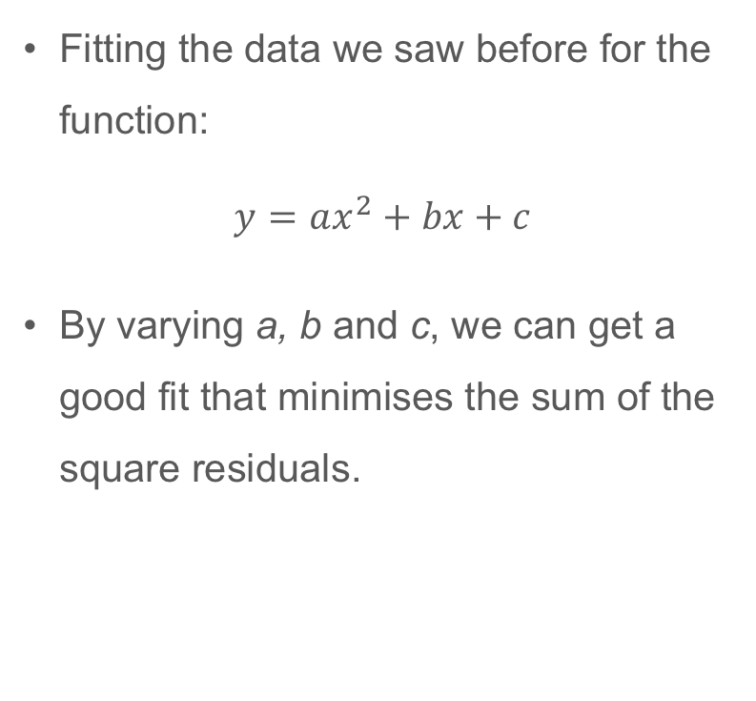
Curve fitting - general procedure
Fitting the data we saw before for the function:
$$y=ax^{2}+bx+c$$
By varying a, b and c, we can get a good fit that minimises the sum of the square residuals.

Slide 9
Before we start - we need to know what a function is
We’re going to come back to functions at a later stage, but functions are very useful constructs in programming. They can help to make code look tidier and more readable.
We have already seen examples of functions when we call things like:
numpy.sqrt(3.0)
When we do this, we are basically calling a function.
What are functions then?

Slide 10

Functions
You should be used to the idea of a function in mathematics. For example, $f\left(x\right)=x^{3}$. If I said to you, what is $f\left(3\right)$, hopefully(!) you could tell me the answer.
You would take three and cube it. You may be used to the input/output idea.
3
3³
27
Input
Function
Output

Slide 11
Functions
Well, functions in programming are based on the same idea. But, they can be as simple or as complex as you wish.
A function can do one thing, or it can do a whole array of things. It can even call other functions…
Let’s just look at a basic example first. Say you had some problem where you wanted to find the product of two numbers (say a and b and divide it by a third, c. So, you want:
a*b/c

Slide 12
Functions
In Python, this would look like:
def my_function(a,b,c):
return a*b/c
If you wanted to use this function in your code, you would then write:
my_function(a,b,c)
Task: Define a function as above. Then use a loop to find: 1*2/3, 2*3/4, 3*4/5, 4*5/6 and 5*6/7

Slide 13
Curve fitting example
Now, let’s take a look at example 3 of this lecture.

